Slide 1
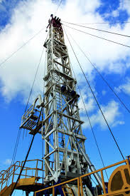
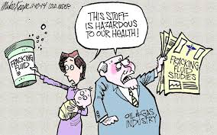
Economic vs. Environmental
Hydraulic Fracturing
Fracking in Latin America
Mianu Ortega, Meylin Gonzales, Cecilia Gas, & Paola Escamilla

Slide 2
What is fracking?
Vertical well bores are drilled thousands of meters into the earth, through sediment layers, the water table, and shale rock formations in order to reach the oil and gas underneath.
A cement casing is installed and will serve as a conduit for the massive volume of water, fracking fluid, chemicals and sand needed to fracture the rock and shale.
The fractures allow the gas to be removed from the formerly impervious rock formations.

Slide 3
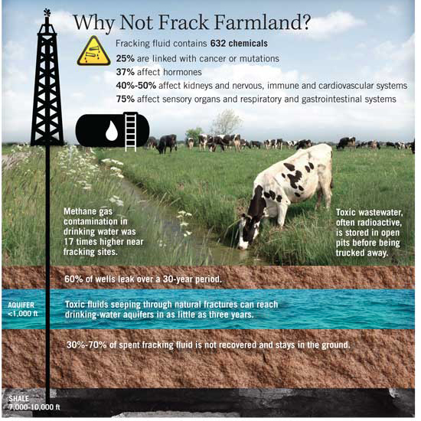
Risks
Environmental, human and social risks
Water pollution and Soil Contamination
Earthquakes
Direct effects on human health
Air pollution
Noise and Light pollution
Violation of human rights
Acceleration of climate change
Economic rationale

Slide 4
Energy production and consumption in Latin America:
An Overview

Slide 5
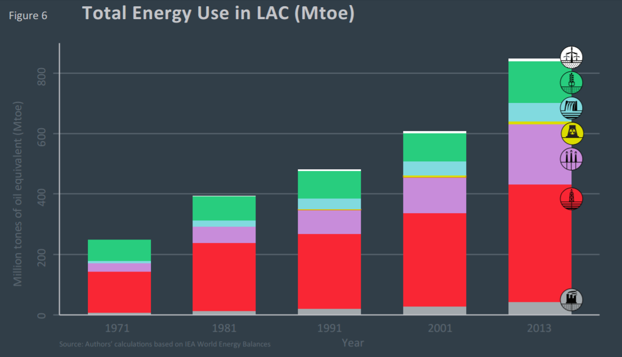

Slide 6
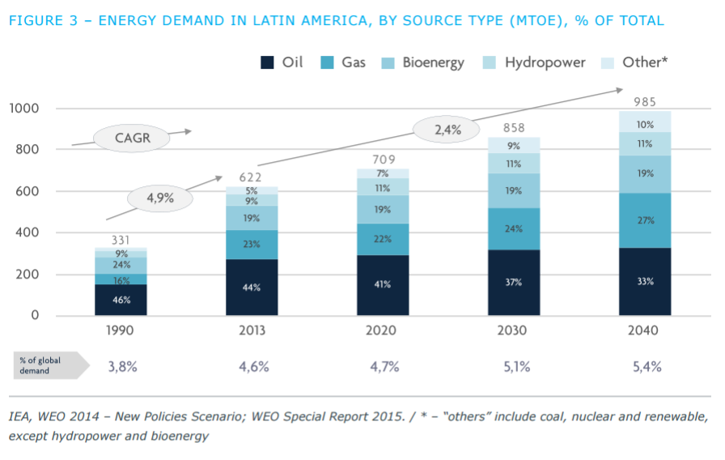
Notes:
MTOE: Millions Tonnes of oil equivalent

Slide 7
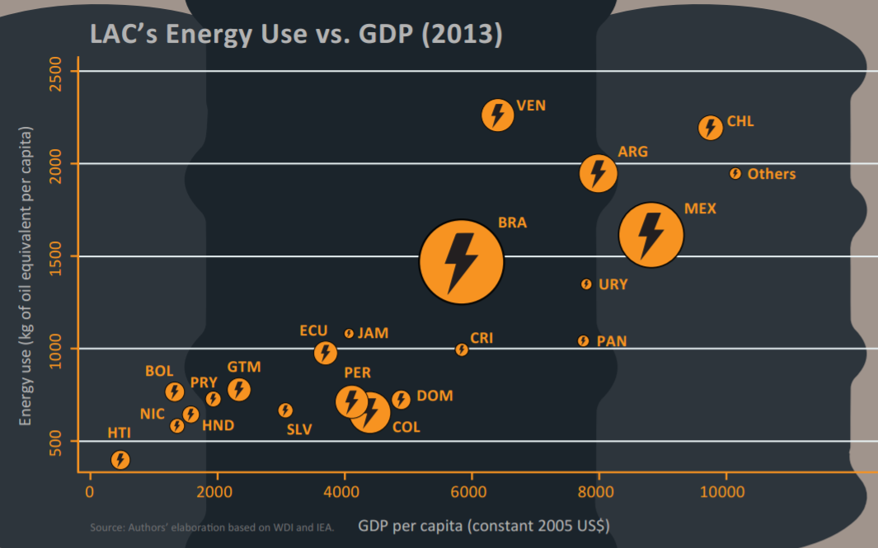
Notes:
Inter-American Dev. Bnak 2013 Report on Energy Use in LAC
Shows variation depending on GDP.
Area in circle proportional to country population

Slide 8
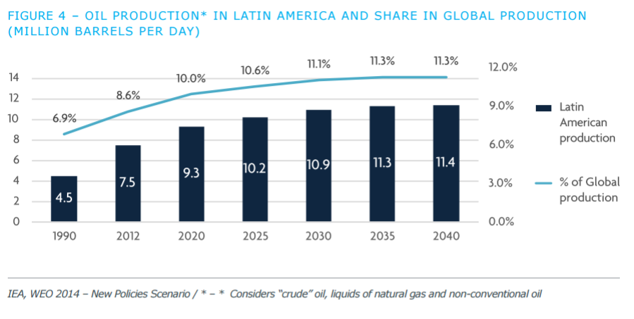

Slide 9
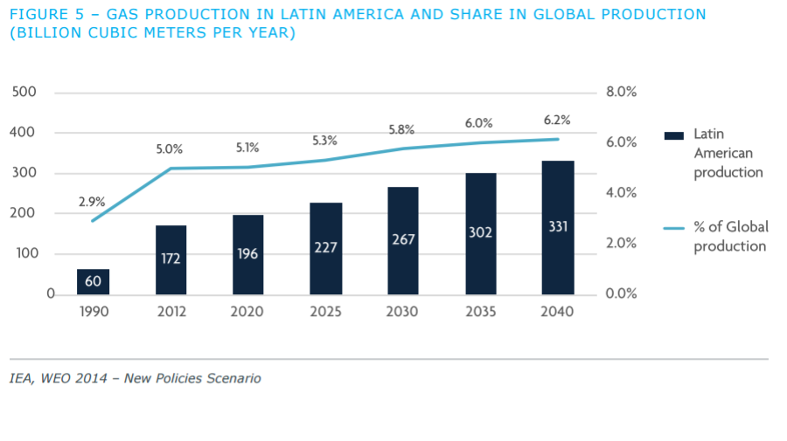

Slide 10
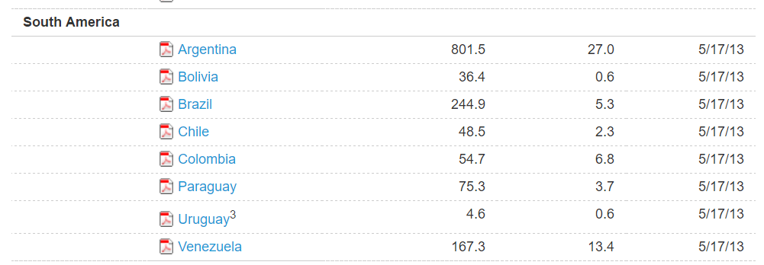
Argentina -2nd Mexico - 6th
Brazil - 10th
Based on EIA report for technically recoverable shale reserves
Notes:
BP Statistical Review of World Energy 2016 -
CHECK THIS! FIX THIS AND CROP! http://www.bp.com/content/dam/bp/pdf/energy-economics/statistical-review-2016/bp-statistical-review-of-world-energy-2016-full-report.pdf
World Shale Resource Assessments from IEA at https://www.eia.gov/analysis/studies/worldshalegas/

Slide 11
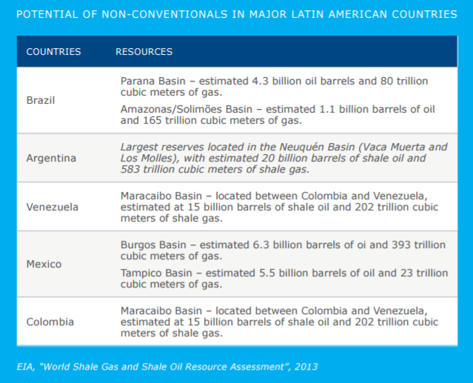
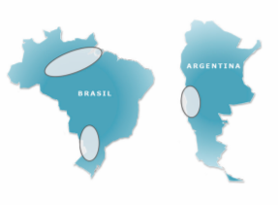

Slide 12
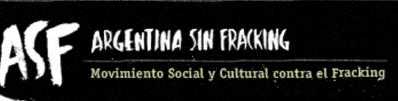
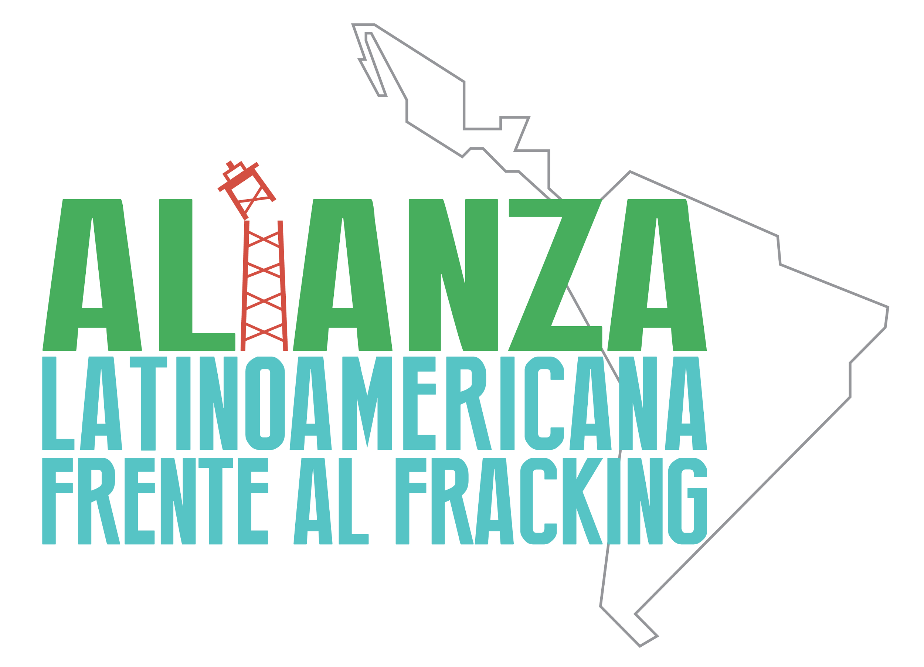
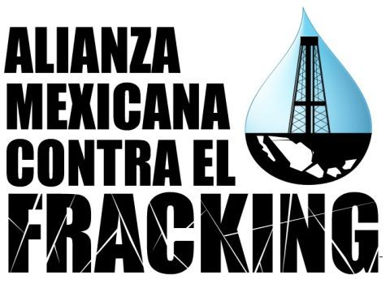
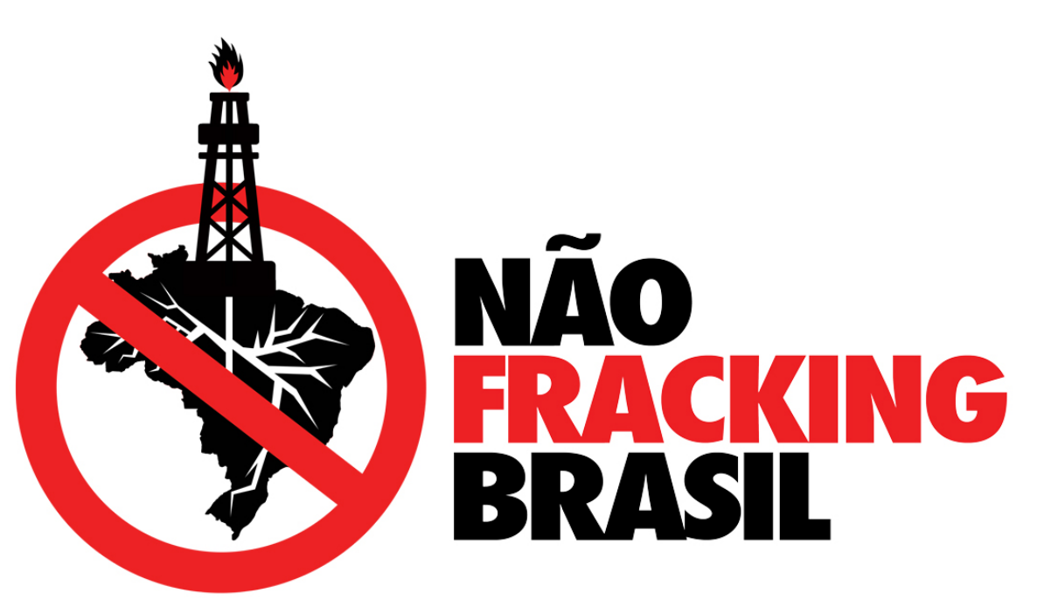
Main issues targeted:
Water pollution - water supply
Health concerns
Land rights
Notes:
mexico with indigenous?
experimental technique based upon estimates

Slide 13
How has hydraulic fracking affected public policy and civil society in Latin America?
Notes:
varies accross countries
more data on argentina and mexico
modified all their politics to open up to this possibility

Slide 14
New Extractive Frontiers
Cases of Argentina and Mexico

Slide 15
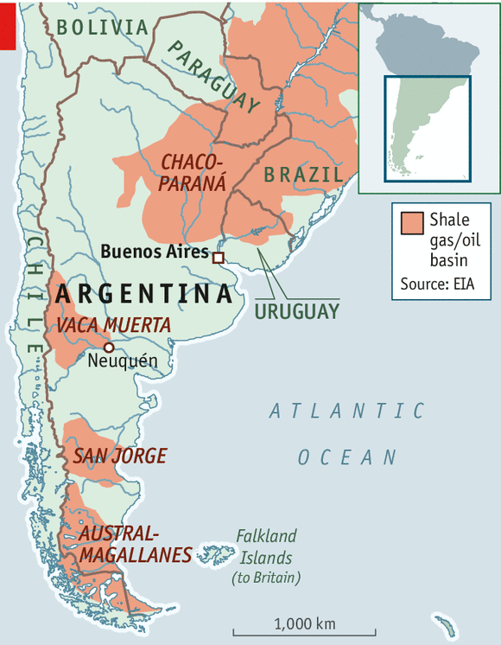
Case of Argentina
High dependence on fossil fuels
1990 sharp decrease on its energy reserves due to privatization
2010 Repsol-YPF discovered the Vaca Muerta Formation, a shale gas reservoir

Slide 16
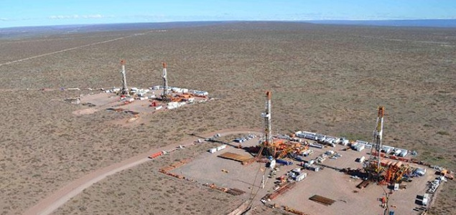
Public Policy in Argentina
2012 adoption of the “Ley de Soberanía Hidrocarburífera”. The company YPF (Yacimientos Petrolíferos Fiscales) goes back to the State: no real effect.
More pragmatism and association with big multinationals such as Chevron, Petronas and Gazprom
2014 reform to the Law to open up new frontiers for the oil industry which lead to the creation of the “Concesión de Explotación No Convencional de Hidrocarburos”
Fracking in Argentina has been greatly stimulated by the US through private-public lobbying

Slide 17
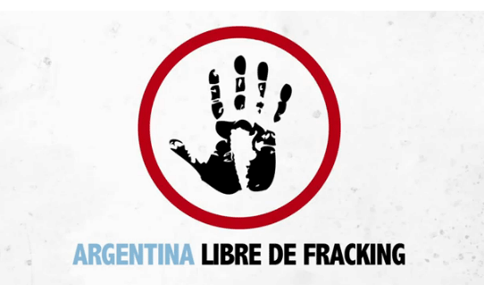
Civil society
Violations
Indigenous rights
Lack of environmental and social Impact Assessment
Lack of free, prior and informed consultation process
Violation of the right to information
Criminalization of social protests
Achievements
Strong social movements since 2010
In 2016, 45 (out of 667) municipalities were declared are free of fracking in the provinces of Entre Ríos, Mendoza, Buenos Aires, La Pampa, Río Negro, Neuquén y Chubut.

Slide 18
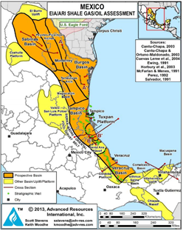
Case of Mexico
As of 2004, production has declined
Fracking technique is introduced in the conversation since 2008
Studies by EIA → estimate 13,1 billion of oil barrels &
Studies by PEMEX → 31,9 billions of oil barrels
Burgos Basin is the key exploited area: Estimated to hold 25 275 MMbpce (Millions of barrels of crude oil equivalent)
Currently: 28 fractured wells between 2010-2015:
14 in Coahuila, 8 in Nuevo León and 6 in Tamaulipas

Slide 19
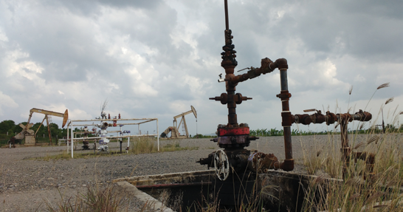
Public Policy in Mexico
National Development Plan 2013-2018 → Introduction of non conventional hydrocarbon exploitation through fracking → Consolidated with the Energetic Reform approved in 2013
In 2014 implementation phase begins.
First assignations were delivered to PEMEX and in 2015, 24 first tenders were published including 24 areas of non conventional hydrocarbons (to be explored for the next 5 years)
In 2016, official permits were given for the first 3 non conventional wells in veracruz and Tamaulipas
There is no specific normative related to fracking. It is encouraged by the reform, however the legal content does not include concrete measurements for its appliance or implications.

Slide 20
Civil Society
Organisations and collectives have emerged: Alianza Mexicana vs el Fracking, ChihuahuaVsFracking, No al Fracking Nuevo León and No al Fracking Tamaulipas
Claim: Energetic model means important social, environmental and climate impacts
Purpose: To develop and diffuse information and strengthen the defense of territory
Free prior and informed consent (ILO Convention 169)
Achievements: Activity blocked in the northern mountain chain of Puebla, Emiliano Zapata community in Veracruz, Xilitla municipality in San Luis Potosi and municipality of Tanlajás

Slide 21
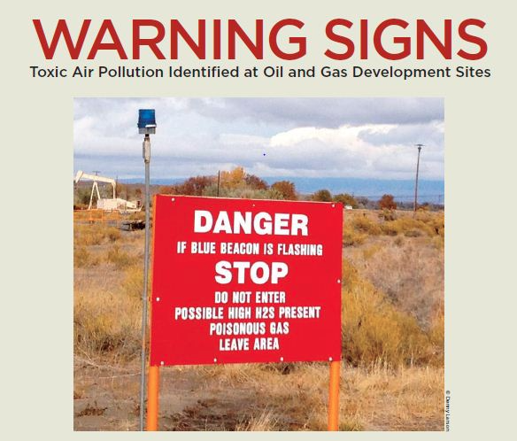
Food for thought...
Why are we damaging our environment and continue to exploit excessively our resources instead of focusing on modifying our lifestyle?
Unconventional extractive methods are leading to unconventional politics (Szeman, 2013) - How far are governments willing to go to hold power?
Regarding hidden mechanism of extraction and infrastructure, the fact that we can’t see how fracking happens (everything happens in the subsoil), what are the implications for communities’ imaginary or understanding of the process?
April 5, 2017

